Slide 1
Mobilizing CRM One Step at a Time
Mark Wright, Sybase Senior Systems Consultant
Nora Tucker, Sybase Product Marketing Manager
Bill Laberis, IDG

Slide 2
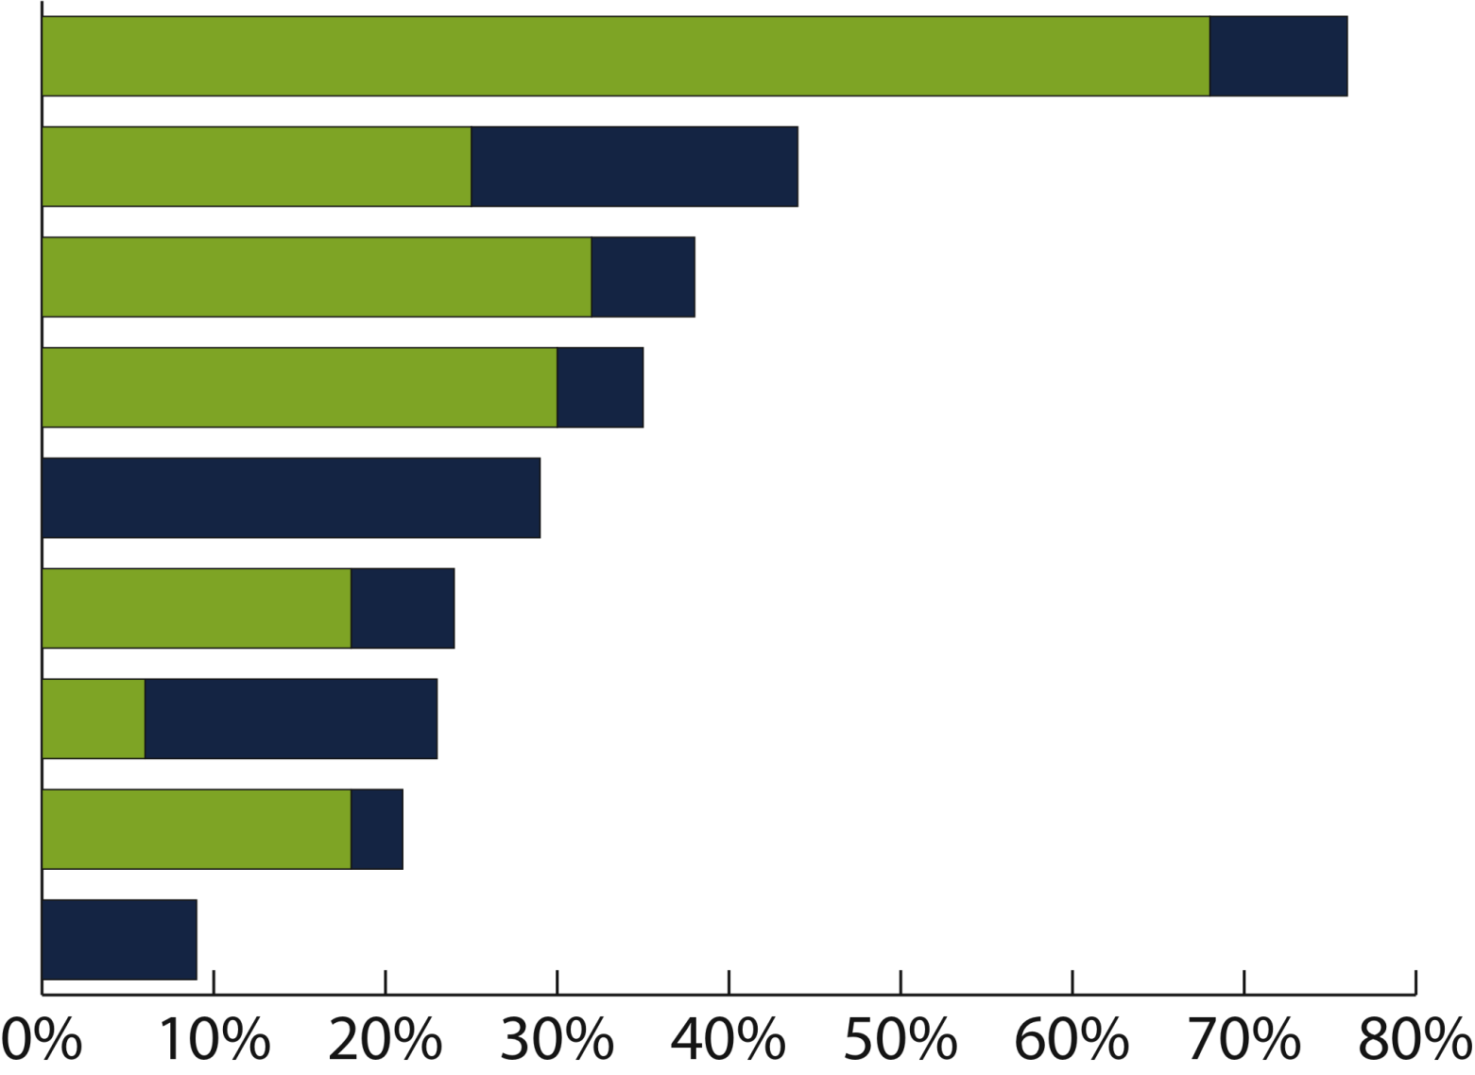
PLATFORM PROLIFERATION
BlackBerry devices
68%
8%
Apple iPhone
25%
19%
Windows Mobile 6.x devices
32%
6%
“Features” phones
30%
5%
Windows Mobile 7.0 devices
29%
Will replace 6.x in 2010
SymbianOS devices
18%
6%
Google Android devices
Currently using
Plan to implement within 12 months
6%
17%
PalmOS devices
18%
3%
Palm WebOS devices
9%
Source: Aberdeen Group, March 2009

Slide 3
ORGANIZATIONS NEED TO SUPPORT MULTIPLE DEVICES AND PERSONALLY-OWNED DEVICES
We feel it is important to support multiple handheld device types to meet employee expectations for functionality
We feel it is important to support employee-owned handheld device types to meet employee expectations for functionality
Q14: Please rate your agreement with the following statements. Base: 106 respondents
Notes:
3

Slide 4
Step 1: Support Multiple Device Types
Explosion of device types entering organizations today
Rise of new platforms beyond BlackBerry, such as
iPhone and Android
Broad reach of many mobile applications across entire enterprise
Different devices for different user segments
Clear need for a flexible, device-agnostic platform from which to manage and support mobile resources

Slide 5
REAL-TIME ACCESS TO CRITICAL BUSINESS INFORMATION DRIVES MOBILITY INITIATIVES
Q7: What are the primary drivers behind your organization’s handheld mobility initiatives? Base: 106 respondents;
Multiple responses accepted
Notes:
5

Slide 6
MOBILITY INITIATIVES BOOST PRODUCTIVITY, INFORMATION ACCESS AND EMPLOYEE SATISFACTION
Q9: Which of the following benefits has your organization achieved or does your organization expect to achieve within the next 12-24 months from its handheld mobility initiatives? Base: 106 respondents
Notes:
6

Slide 7
Step 2: Provide real-time integration with back-end systems
Rising user demand for mobile CRM connectivity
Need real-time visibility into the business from any location
Clear competitive advantages of not relying on offline data
Promote more effective usage of CRM investments already in place
Need to access information as well as input information with real-time updates to the back-end systems
SAP and Sybase relationship built from engineering to marketing to sales and support
SAP mobile gateway and data orchestration engine enables seamless mobile connectivity

Slide 8
Independent study on information workers
4More than 40% of information workers have the IT department install corporate-sanctioned mobile applications on their smartphones.
432% use their smartphones for work 1-2 hours per day.
443% of IT execs say they are somewhat or very concerned with security issues of using smartphones for business use.
Source: “Understanding Information Worker Smartphone Usage”, Forrester Research, Inc., November 2009.
Notes:
8

Slide 9
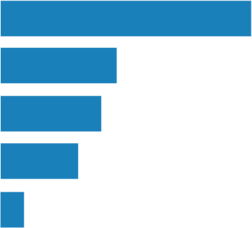
MAXIMUM COST FOR A SINGLE MOBILE COMPLIANCE LAPSE
Sarbanes-Oxley (SOX, JSOX)
$2,100,000
Global privacy regulations
$1,500,000
Securities and Exchange Commission (SEC) regulations
$1,400,000
Payment Card Industry Data Security Standard (PCI DSS)
$1,300,000
All Respondents
Maximum cost for lapse in US dollars (n=38)
Health Insurance Portability and Accountability Act (HIPAA)
$1,100,000
Source: Aberdeen Group, September 2009

Slide 10
Step 3: Safeguard data both in transit and at rest
With corporate data, security is of critical importance
Many mobile security schemes put security into place at the server level - not always a good idea
Must build mobile security that supports compliance with industry standards and regulations
Security must be rigorously standards-oriented

Slide 11
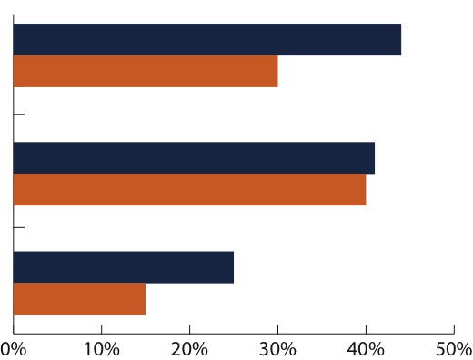
BEST-IN-CLASS STRATEGIES
Ensure all mobile devices with enterprise access are corporate compliant
44%
30%
Manage, maintain, and control all mobile devices that have enterprise access
41%
40%
Best-in-Class
All Others
Standardize on ONE mobile platform across the enterprise
25%
15%
Percentage of All Respondents (n=162)
Source: Aberdeen Group, June 2009

Slide 12
STEP 4: PROVIDE TRANSPARENT DEVICE MANAGEMENT
Must develop strategy for supporting field devices remotely
Device management must be made as user-transparent as possible
Device management comes clearly to the fore with iPhone due to myriad of apps available to all users (and inherently personal nature of the device)
Provisioning as well as decommissioning must be simple and quick

Slide 13
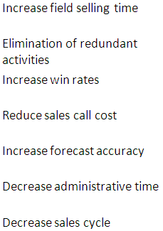
ROI ON MOBILE CRM SOLUTIONS
Realized or expected % improvement on metrics from implementing mobile sales force automation technology and services for US in 2008.
Source: Yankee Group, Anywhere Enterprise-Large: U.S. Mobility and Business Applications Survey, December 2008.
Notes:
13

Slide 14
Best Practices and Conclusions
4Step 1 - Support multiple device types
4Step 2 - Provide real-time integration with back-end systems
4Step 3 - Safeguard data both in transit and at rest
4Step 4 - Provide transparent device management

