Slide 1
Gain Your Competitive Edge Through Mobility In 2010
Willie Jow
VP of Mobility Product Marketing
December 2009

Slide 2
eSeminar Abstract
There is no doubt that key mobility enablers are in place – high speed networks, a range of powerful handheld devices and comprehensive application platforms can now be leveraged to mobilize your enterprise. However, the mobile opportunity is only as good as the strategy and tactics in place to capitalize on these new capabilities. Basic email and PIM mobile solutions are no longer a competitive advantage, but rather a business necessity. In this eseminar you will learn how to view mobility as a way to fundamentally change the way business is conducted as opposed to simply extending your existing systems to the mobile edge. Only through this new lens can you deliver a mobile solution to truly outdistance your competition.
Key learnings from this fast paced, informative seminar led by expert presenters include:
How to go beyond basic email and PIM mobility to truly deliver the applications your mobile workforce requires
How a “greenfield” approach can give you a mobility strategy which your company’s competitors cannot match
How to enable your IT department with the proper tools and build a business case for your company’s mobile investment

Slide 3
2010: Time to Move Beyond Basic Mobility
Fundamentally change
the way business is conducted
using the “green field” approach
to enterprise mobility

Slide 4
Mobility is Becoming Business Critical
70%
of all workers will be mobile by 2012*
60%
of enterprises have mobilized two or more applications*
*source: Forrester & IDC 2009

Slide 5
Millenials are Driving Enterprise 2.0
Introducing consumer technologies in to the enterprise, including:
Social networks
Microblogs
Online videos
Presence
Increased expectations with respect to:
Ease-of-use
Appearance
Functionality
Connectivity

Slide 6
Enterprise Mobility Today: Field Service
FIELD SERVICE TECHNICIANS
CHALLENGE To provide near real-time access to scheduling, customer information, repair history and inventory levels
TYPICAL RESULTS
Increased employee productivity, resulting in more customer visits per day
Decreased costs
Improved inventory management
Increased customer satisfaction
Increased employee satisfaction

Slide 7
Enterprise Mobility Today: Mobile CRM
FIELD SALES FORCE
CHALLENGE To provide near real-time access to business critical information, including opportunities, leads, account information and pipeline analysis
TYPICAL RESULTS
Increased productivity and effectiveness
Increased value and ROI of CRM
Shortened sales cycles
Increased customer satisfaction
Increased employee satisfaction

Slide 8
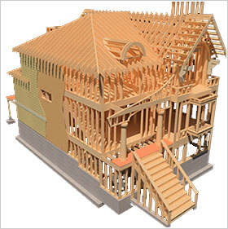
But…Where is the Innovation?
Today
Tomorrow
Most enterprises view mobility simply as a way to extend existing applications to the mobile edge
Fundamentally change existing business processes by harnessing the power of mobile devices

Slide 9
The “Green Field” Approach
Think across the entire enterprise
Who could mobility impact and how?
Take inventory
List all applications and processes currently in use, along with the size of the user base and frequency of use
Learn
Observe a “day in the life” of employees and visualize how that could be impacted by mobility

Slide 10
The “Green Field” Approach
Outline existing workflows
Identify steps to combine or remove
Research new technologies
How can Web 2.0 technologies be leveraged?
Enlist the help of Millenials
Tap existing in-house knowledge of the latest technologies and their potential impact inside the enterprise

Slide 11
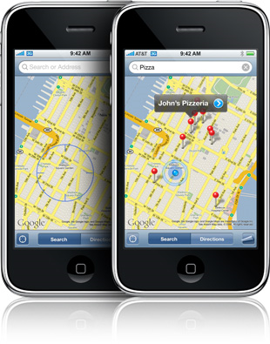
Example of Green Field Thinking
Digital maps completely changed the way people use and rely on location data – from turn-by-turn personal navigation to location-based marketing and services.

Slide 12
Building Your Mobility Business Case
Start small, but move rapidly
Start with a pilot project that can show immediate ROI but rapidly expand your enterprise-wide solution from there
Create an enterprise wide mobile strategy
Ensure your mobility investment can evolve in step with critical data sources and mobile technologies
Calculate expected ROI gains across the organization
Don’t discount “soft” productivity benefits
Leverage the use of personal devices in the enterprise

Slide 13
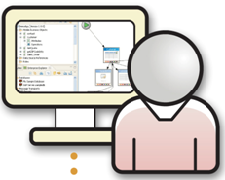
Mobile Platforms Tame Complexity
Enterprise Data Changes
Consistent Development Platform
Device Technology Changes
Offers seamless integration to a variety of back-end data sources
Enterprise-grade development environment leveraging existing skills and technologies
Enables rapid deployment of mobile applications across multiple device types
Sybase Unwired Platform
Strategically adapt to the rapidly changing world
with the use of a mobile enterprise application platform

Slide 14
Sybase Unwired Platform Defined
Heterogeneous
data sources
Heterogeneous
mobile devices
Databases
Blackberry
Sybase Unwired
Platform
iPhone
Web
Services
Symbian
Software
Applications
Windows 32
Files
Windows Mobile
Sybase Unwired Platform
is a comprehensive mobile enterprise application platform
on which you can strategically build your “green field” mobility initiatives
10
Notes:
14

Slide 15
Mobility Reminders
Other important factors to consider before deploying a enterprise mobility solution:
Mobile device management and security
Application management and provisioning
Data synchronization
IT governance
User adoption and training

Slide 16
Sybase Customer Success with Mobility
LARGE BOTTLING COMPANY
CHALLENGE
Create mobile solutions to increase the productivity of workers across the entire enterprise
SOLUTION
Sybase Unwired Platform
WHY SYBASE?
Reputation as visionaries in the mobility space
Future-proof solution that supports any device connecting to any back end data source
Strong SAP partnership

Slide 17
Sybase Customer Success with Mobility
GLOBAL HEALTH COMPANY
CHALLENGE
Create a consistent mobile architecture worldwide that can be leveraged both now and in the future
SOLUTION
Sybase Unwired Platform
WHY SYBASE?
Solid mobile infrastructure built on proven mobile technology
Proven worldwide mobility expertise
Trusted long-term “strategic mobility supplier” enforced by external endorsements

Slide 18
Find Your Green Field
Think across the entire enterprise
Take inventory
Learn about a typical “day in the life”
Outline existing workflows
Research new technologies
Enlist the help of Millenials

Slide 19
Enterprise Mobility Blog
www.sybase.com/mobilityblogs
MOBILITY TRENDS & SOLUTIONS
The Sybase Enterprise Mobility Team
Enterprise Mobility Blog: A View from the Inside
Join the Enterprise Mobility Bloggers as they discuss Sybase products, industry trends, news and events.
THOUGHT LEADERSHIP
Willie Jow VP of Mobility Product Marketing Sybase
Monthly Feature
In this monthly article, featured on the Enterprise Mobility Blog, Willie Jow dives into challenges and strategic opportunities within the mobile enterprise.
Notes:
19

